Slide 1


Paper ID : 482
TITLE: StrokeGuardian: Hybrid Ensemble ML for Real-Time Brain Stroke Prediction and Clinical Decision Support
Mohammed Sakib Hasan , Abdul Jobayer , Jihadul Islam, Sanjida Islam Nuha , Golam Md. Muradul Bashir
Faculty of Computer Science and Engineering
Patuakhali Science and Technology University, Bangladesh
Presented By: Jihadul Islam
_{B.Sc. Engg. in CSE}

Slide 2
Outlines
Introduction
Literature Review / Related Work
Problem Statement
Motivation and Objectives
Methodology
Results, Analysis, and Discussion
Impact, Outcomes, and Limitations
Conclusion and Future Work

Slide 3

Introduction
Stroke is a leading cause of death & disability worldwide
15 million+ cases annually
50% of survivors face permanent impairment
Early detection is critical, but traditional tools are limited

Slide 4
Related Works
Rana et al. – Stroke Risk Prediction Using Random Forest and SMOTE with Web Application – 2025
Chowdhury et al. – Deep Learning and Ensemble-Based Frameworks for Brain Stroke Prediction: A Comparative Study – 2025
Lakshmi et al. – *Hybrid Deep Learning Framework for Stroke Detection using EfficientNetB0-BiLSTM* – 2025
Sharma et al. – Comparative Analysis of Machine Learning and Deep Learning Algorithms for Brain Stroke Prediction – 2024
Nantinda et al. – A Comprehensive Review of Machine Learning Models for Stroke Risk and Post-Stroke Outcome Prediction – 2024

Slide 5
Problem Statement
Most models are tested in controlled settings, not in noisy clinical environments.
Models often fail when faced with imbalanced, incomplete, or multi-source clinical data.
Few systems offer live risk assessment with a clinician-friendly interface.

Slide 6
Objectives
Motivation
Stroke is a leading cause of death & disability worldwide
Combines models for richer, more accurate predictions
We built a real-time system doctors can actually use
Combine Neural Networks, SVM, and XGBoost into a weighted voting system for superior accuracy.
Apply SHAP and LIME to make model decisions transparent and clinically interpretable.

Slide 7
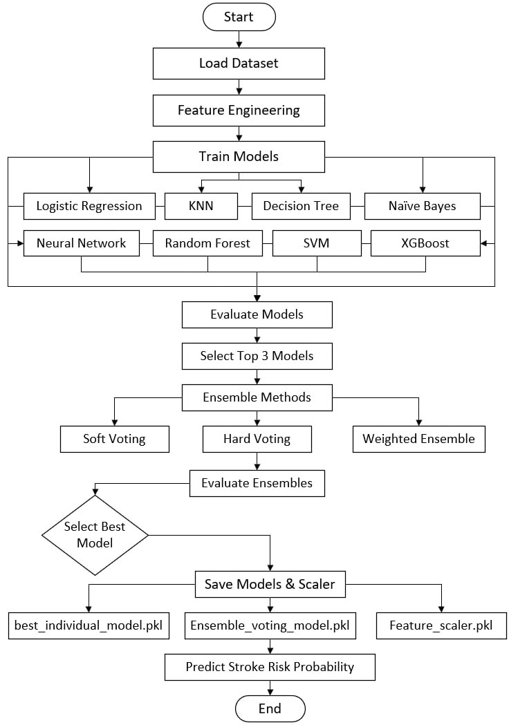
Methodology
Data Collection & Preprocessing
35,000 clinical records, 19 features (age, BMI, glucose, symptoms, etc.)
Binary labels: Stroke Risk (1) vs. No Risk (0)
Publicly sourced from Kaggle (Stroke Risk Prediction Dataset v2)
Preprocessing Steps:
SMOTE – Balanced imbalanced classes
Scaling – Standardized numerical features
Outlier Removal – IQR method for clinical realism
PCA – Reduced dimensionality, removed redundancy

Slide 8
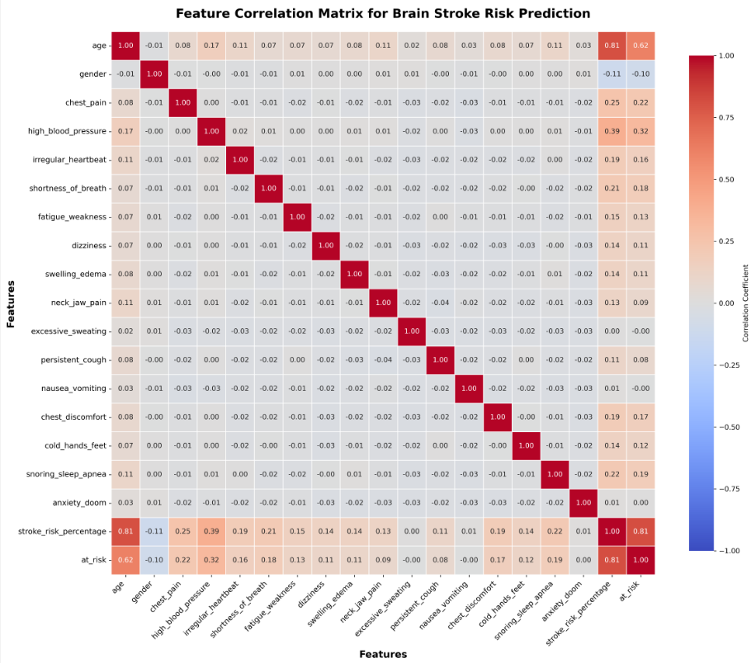
Feature Engineering
Removed highly correlated features (r > 0.85)
Added clinical groupings (BMI/glucose risk levels)
Used SHAP for interpretable feature importance

Slide 9
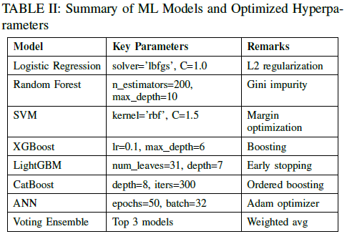
Model Training
Trained 8 models: LR, RF, SVM, XGBoost, LightGBM, CatBoost, ANN, Voting Ensemble
Hyperparameter tuning via GridSearchCV with 10-fold CV

Slide 10
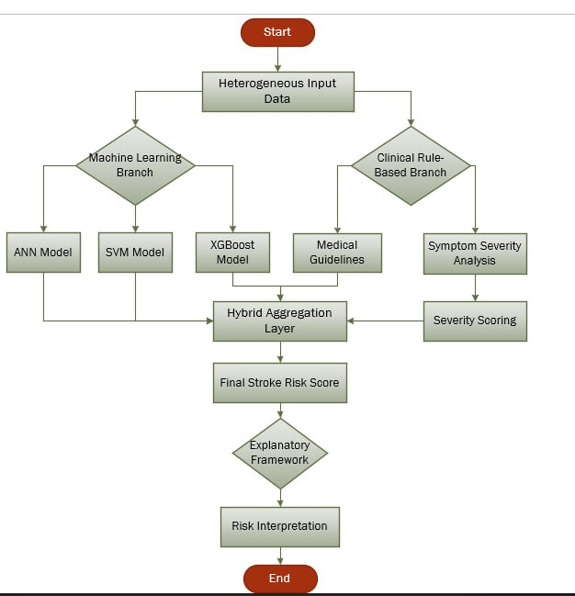
Hybrid Ensemble
Weighted voting: NN (40%), SVM (35%), XGBoost (25%)
Combined for robust, generalizable predictions

Slide 11
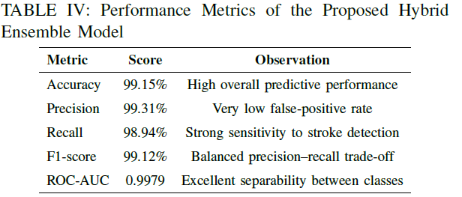
Results, Analysis, and Discussion
Performance Overview
Key metrics table: Accuracy, Precision, Recall, F1-Score, AUC
Highlight: 99.15% Accuracy, AUC = 0.9979

Slide 12
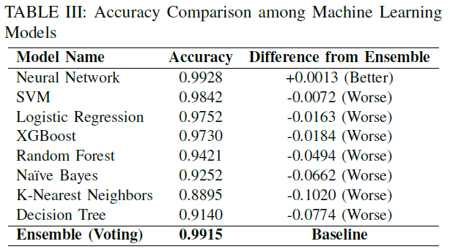
Model Accuracy Comparison

Slide 13
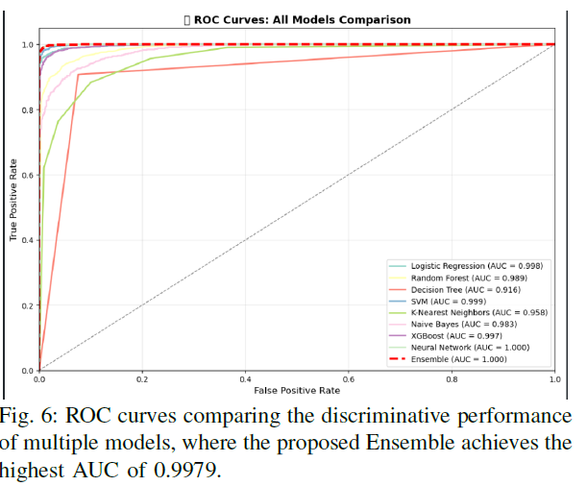
ROC Curve Analysis
ROC curves for top models
Highlight: Ensemble AUC = 0.9979 (best class separation)

Slide 14
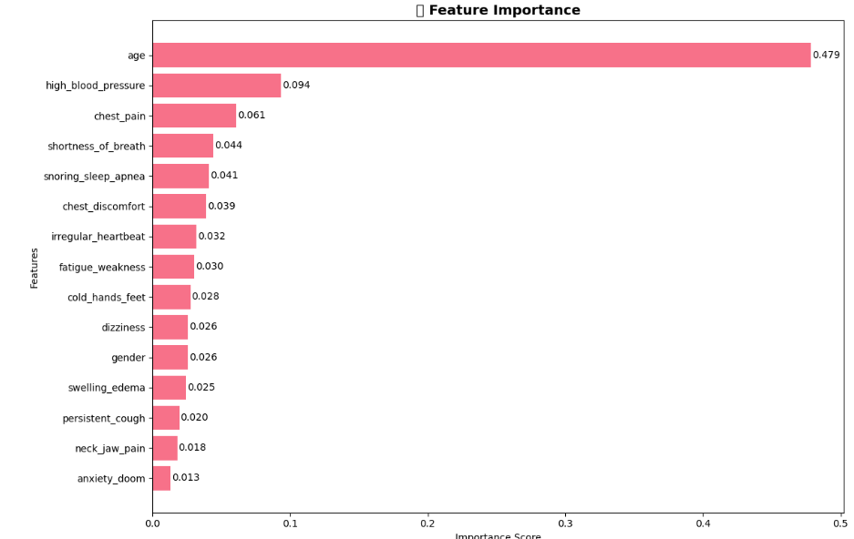
Explainability – SHAP Insights
Top 3 features: Age, Glucose, BMI
SHAP summary plot shows feature impact

Slide 15
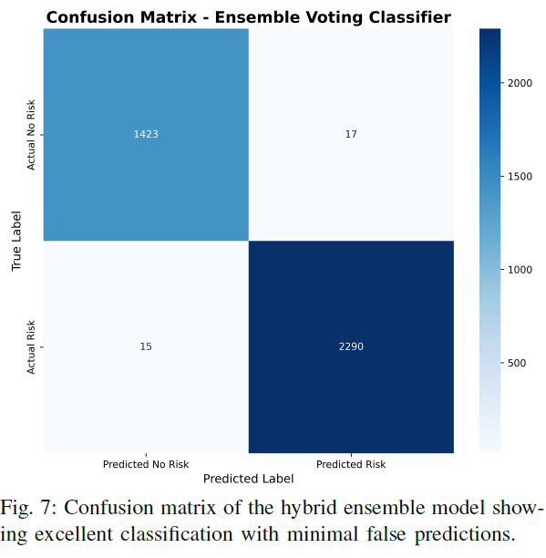
Confusion Matrix
Very high correct predictions: 1423 + 2290 = 3713 correct out of 3745 total cases
Low error rates: Only 17 false alarms (FP) . Only 15 missed risk cases (FN)
Risk detection is strong: The model correctly identifies most risky cases . Very few risky cases are missed (important for safety/finance/health use cases)
Balanced performance: Performs well on both No Risk and Risk classes .No strong bias toward one class

Slide 16
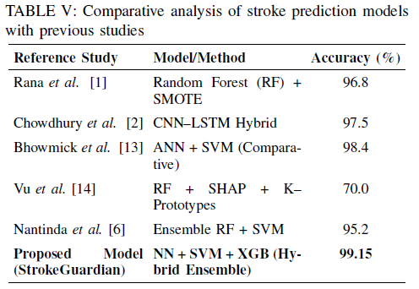
Comparison with Prior Works

Slide 17
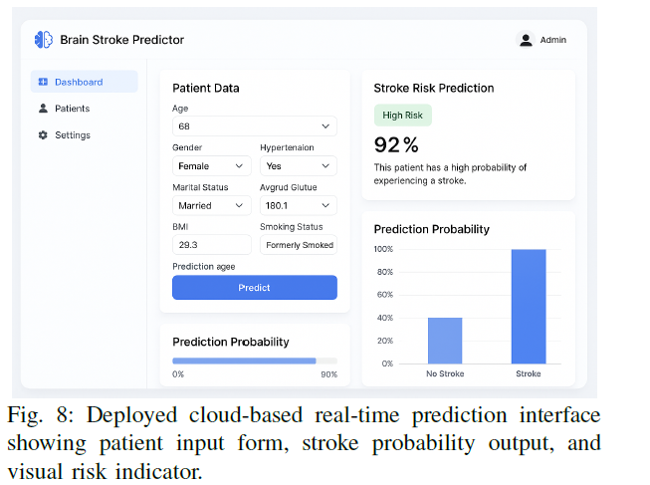
Discussion
Hybrid ensemble = stability + accuracy
XAI = trust + clinical adoption
Real-time dashboard = practical impact

Slide 18
Limitations
Clean data only (no real-world noise)
No external validation yet
Future: test on noisy/multi-hospital data

Slide 19
Conclusion
Developed StrokeGuardian – a hybrid ensemble model combining NN, SVM, and XGBoost for real-time stroke prediction
Achieved 99.15% accuracy & 0.9979 AUC – outperforming existing state-of-the-art models
Integrated Explainable AI (SHAP & LIME) – providing transparent, clinically interpretable insights
Built and deployed a cloud-based clinical dashboard – enabling real-time risk assessment in healthcare settings

Slide 20
Future Works
Real-World Validation
Test on noisy, incomplete clinical data from multiple hospitals
Conduct external validation across diverse populations and healthcare systems
Multimodal Data Integration
Incorporate EEG, MRI, and wearable sensor data for richer patient profiling
Federated Learning Implementation
Enable privacy-preserving, distributed model training across institutions
Support collaborative AI without sharing sensitive patient data
Enhanced Clinical Integration
Develop mobile and EHR-integrated versions for seamless clinician use
Add real-time alerting and recommendation systems for urgent cases

Slide 21


